Slide 1

SplitEase: Simplifying Group Expense Management
Split bills, not friendships! SplitEase is your personal trip expense manager.
BY SHRAVANI GOLE [3028163]

Slide 2

Everyday Chaos: The Problem
Trip Confusion
Manual Errors
Group trips often end in expense confusion.
Manual calculations lead to errors and arguments.
Who Owes Whom?
Its hard to track who paid, how much, and who owes whom.

Slide 3
Market Gaps: The Opportunity
Complexity
Internet Dependent
Missing Features
Existing apps are complex and hard to use.
Require internet access, lack offline features.
Lack smart suggestions and visual analytics.

Slide 4
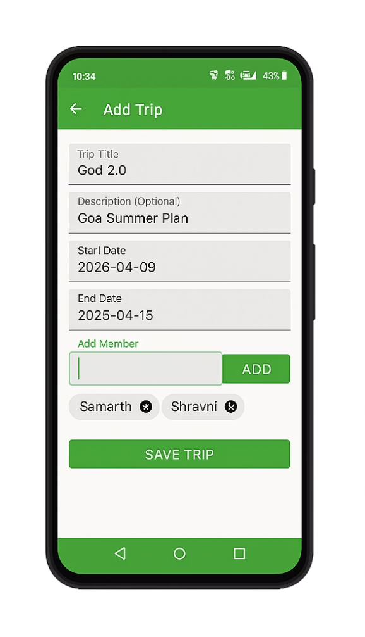



Meet SplitEase: The Solution
Create Trips
Automatic Splitting
Offline Functionality
Easily create trips & add members.
Smart, automatic expense splitting.
Use the app even without internet.

Slide 5

What Makes SplitEase Unique?
Offline-First Design
Visual Analytics
Smart Splitting
Works seamlessly without internet.
Clear expense understanding.
Equal or custom splitting options.

Slide 6



Target Users: Who Benefits?
1
Event Organizers
2
Roommates
3
Friends

Slide 7
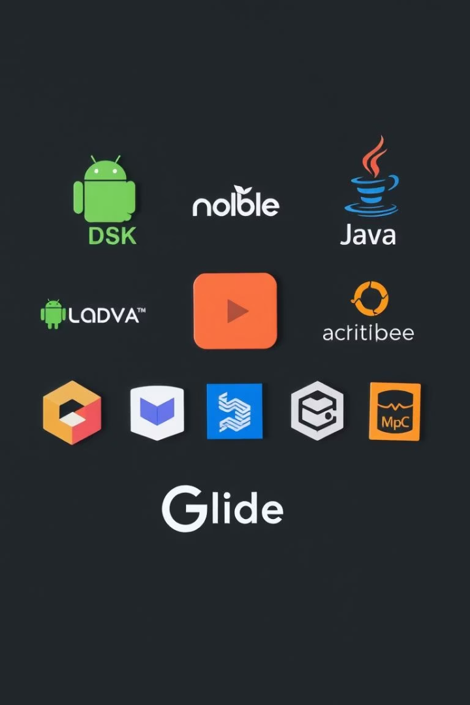
Tech Stack: Built for Performance
1
Android SDK + Java
2
MVVM Architecture
3
Room Database
4
Material Design

Slide 8
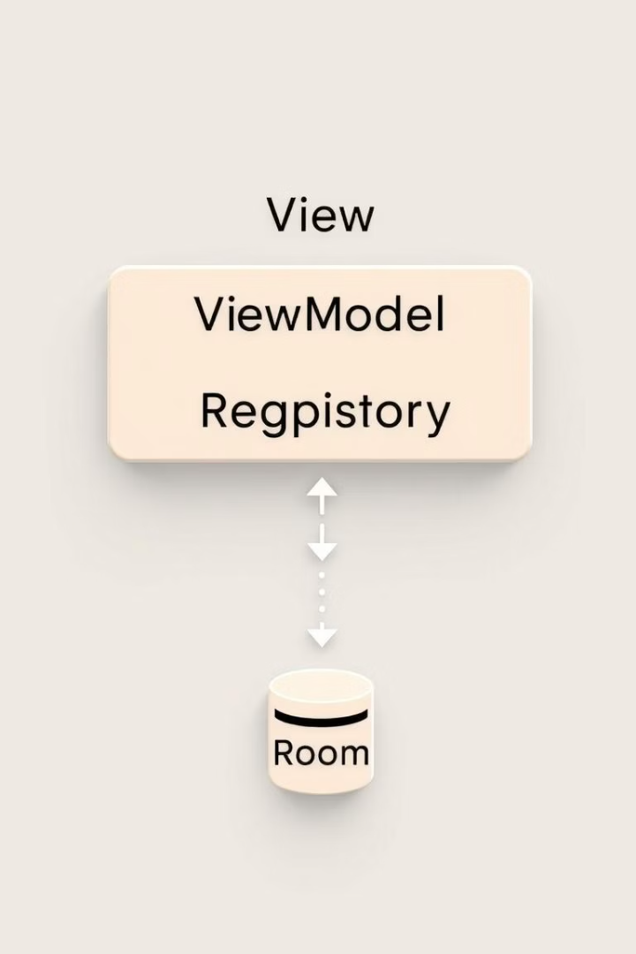



Architecture Overview
UI Layer
User interface and interactions.
Logic Layer
Expense input & calculation.
Data Layer
Data storage and retrieval.

Slide 9




Key Modules: Core Functionality
Expense Tracking
Analytics
Trip Management
Settlement
2
3
1
4

Slide 10

Call to Action: Invest in SplitEase
Simplify expense management and foster better friendships.

